Slide 1
Installing Tensorflow using anaconda

Slide 2
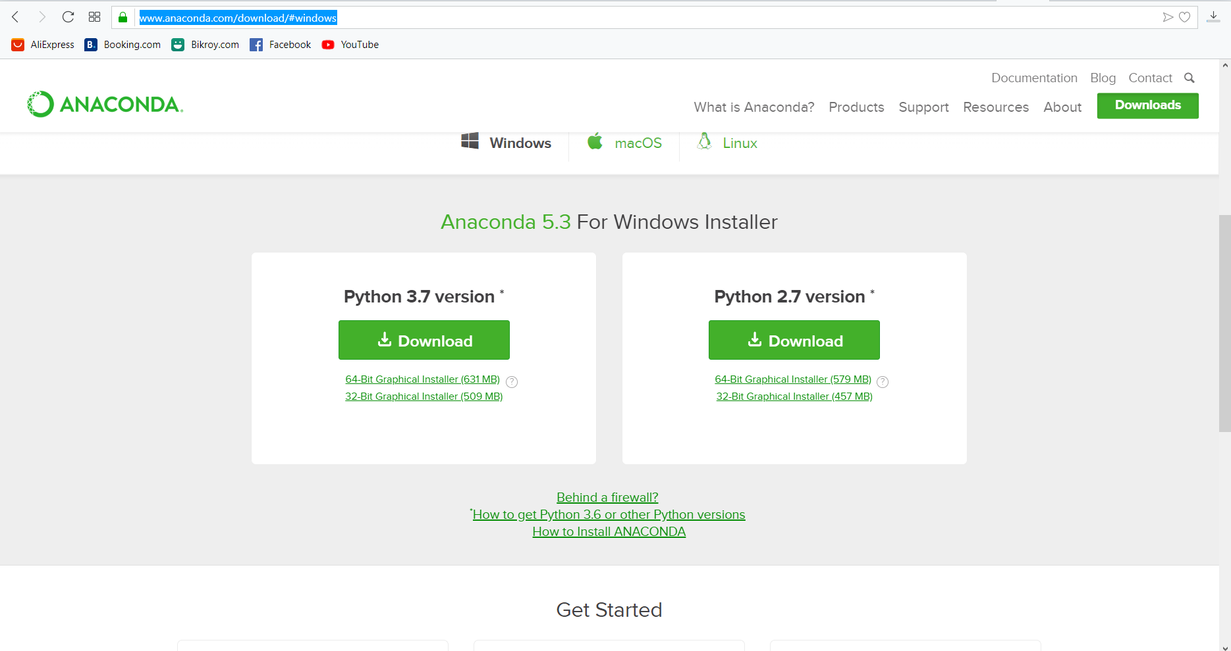
Installing Anaconda
https://www.anaconda.com/download/#windows

Slide 3
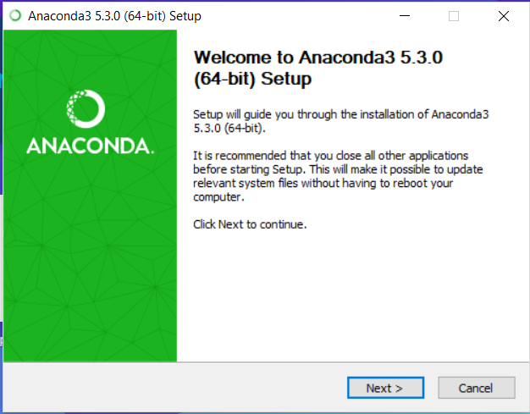
Installing Anaconda (contd.)

Slide 4
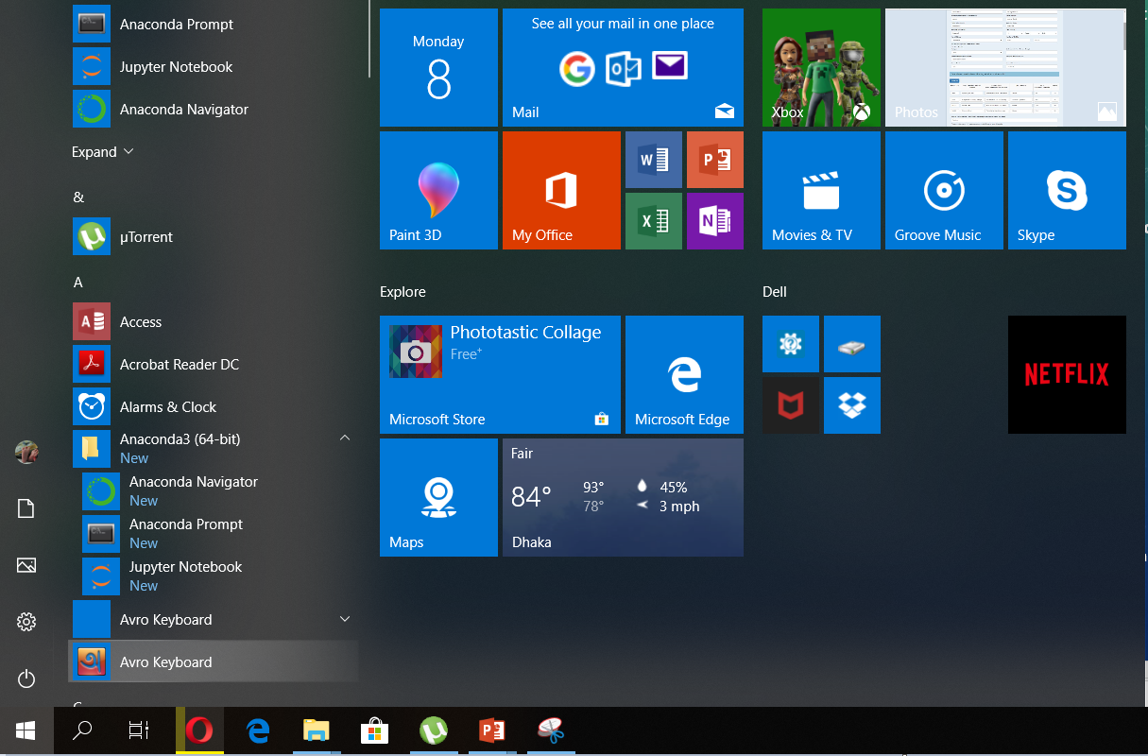

Slide 5
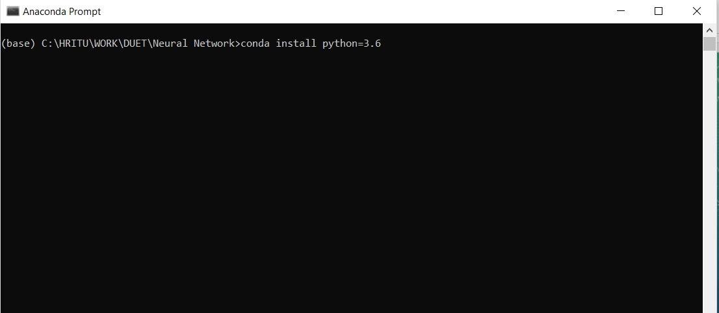

Slide 6
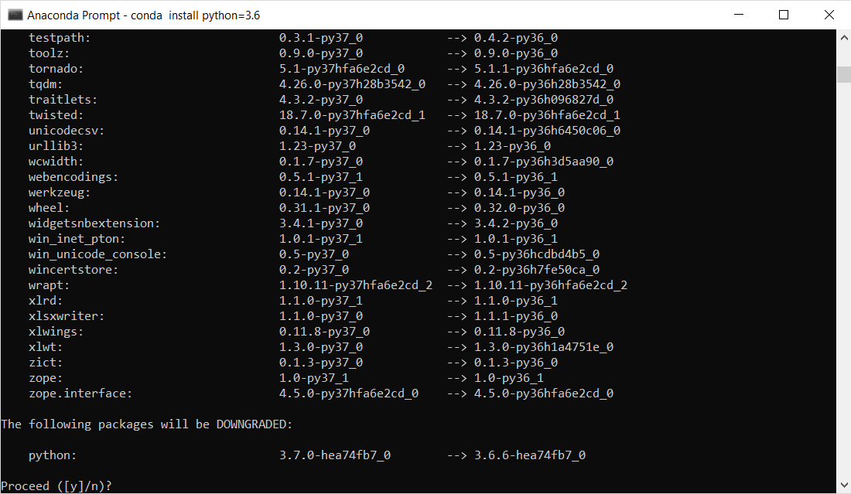

Slide 7
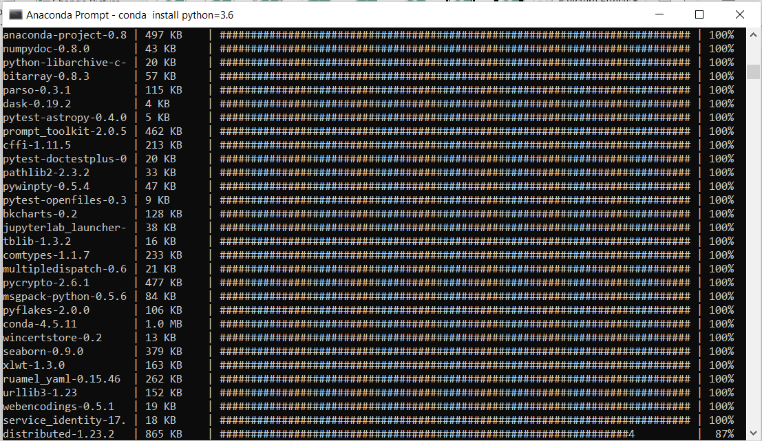

Slide 8
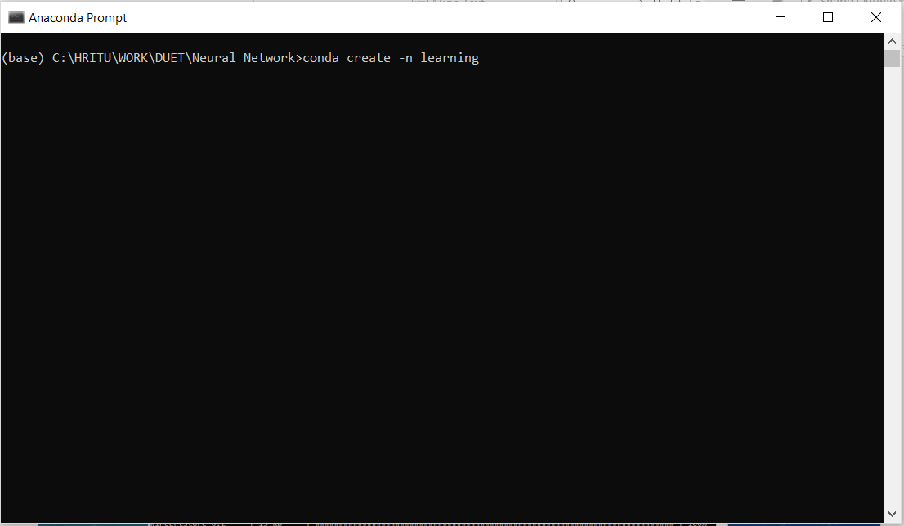

Slide 9
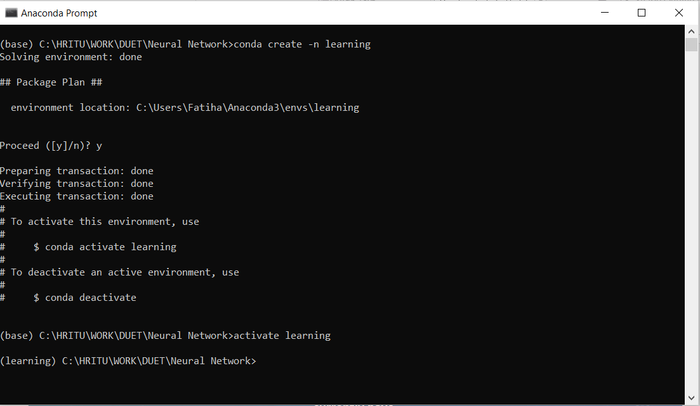

Slide 10
conda install tensorflow
conda install jupyter
Jupyter notebook

Slide 11
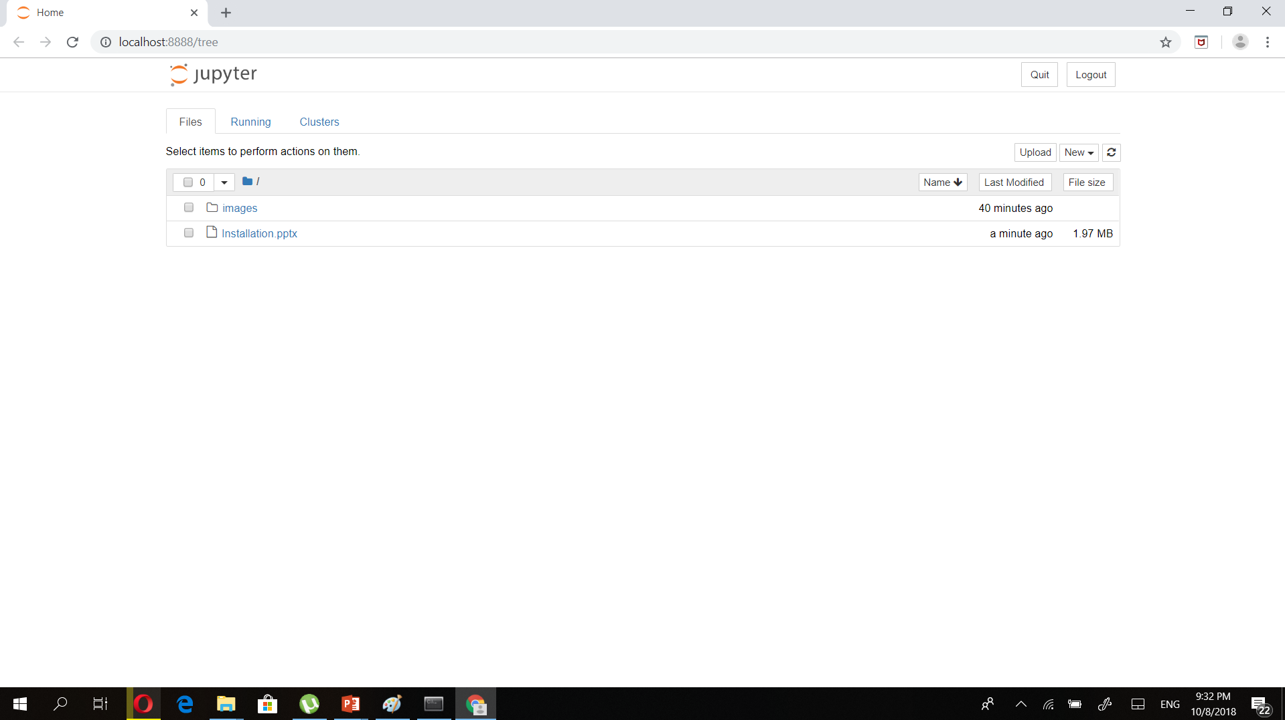

Slide 12
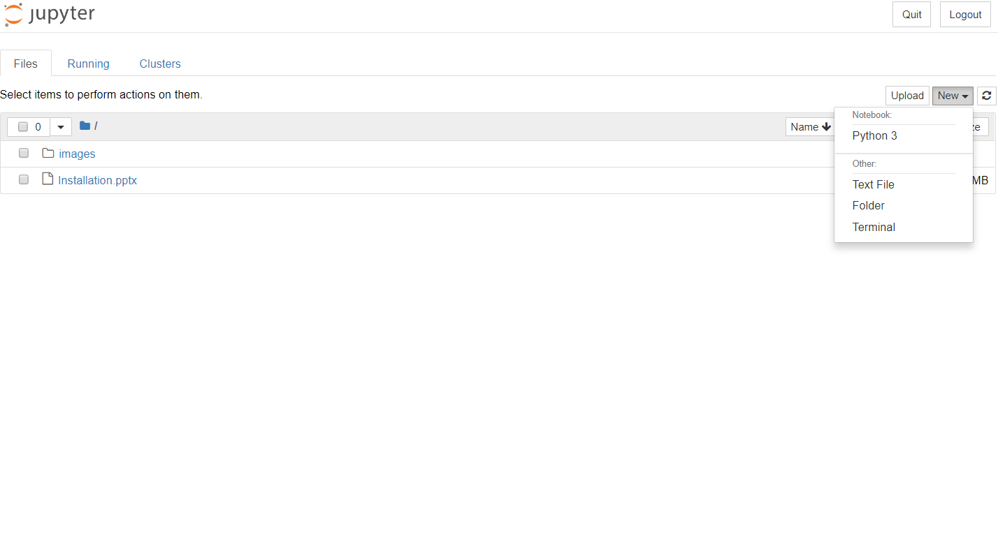

Slide 13
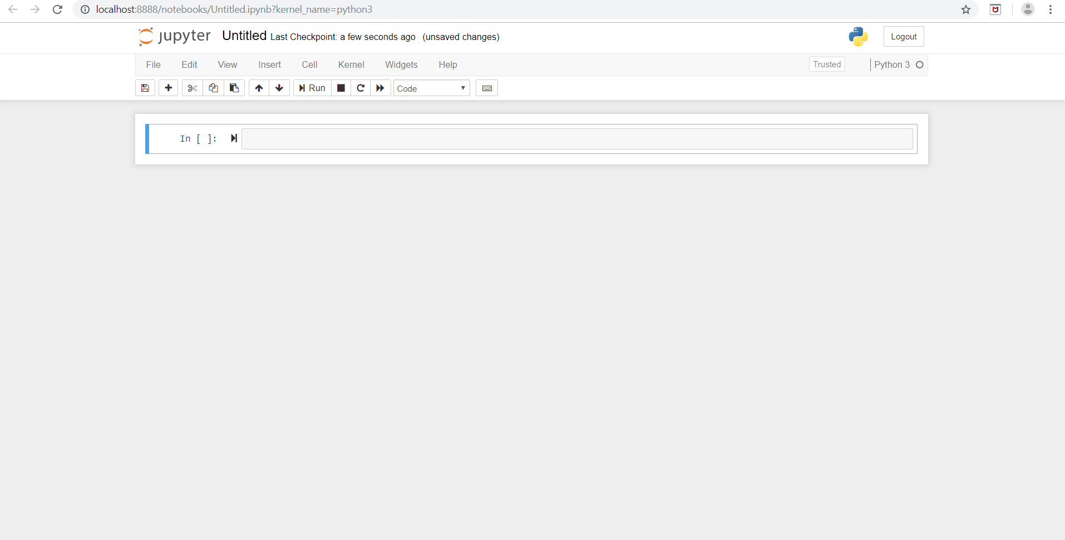

Slide 14
# update conda in your default environment
conda upgrade conda
conda upgrade –all
# create a new environment with conda
conda create -n [my-env-name]
# activate the environment you create
$ source activate [my-env-name]
# take a look at the environment you created
$ conda info
$ conda list
# install a package with conda and verify it's installed
$ conda install numpy
$ conda list
# take a look at the list of environments you currently have
$ conda info –e
# remove an environment
$ conda env remove --name [my-env-name]
Conda is a package manager to manage virtual environment and install packages. Here are some helpful commands using conda:

Slide 15
https://medium.com/@margaretmz/anaconda-jupyter-notebook-tensorflow-and-keras-b91f381405f8
https://www.tensorflow.org/tutorials/keras/basic_classification

